Slide 1
SQL Saturday Baton Rouge 2025
NO FOOD OR DRINKS IN THE CLASSROOMS

Slide 2

















SQL Saturday Baton Rouge 2025
Thank you, Sponsors!

Slide 3

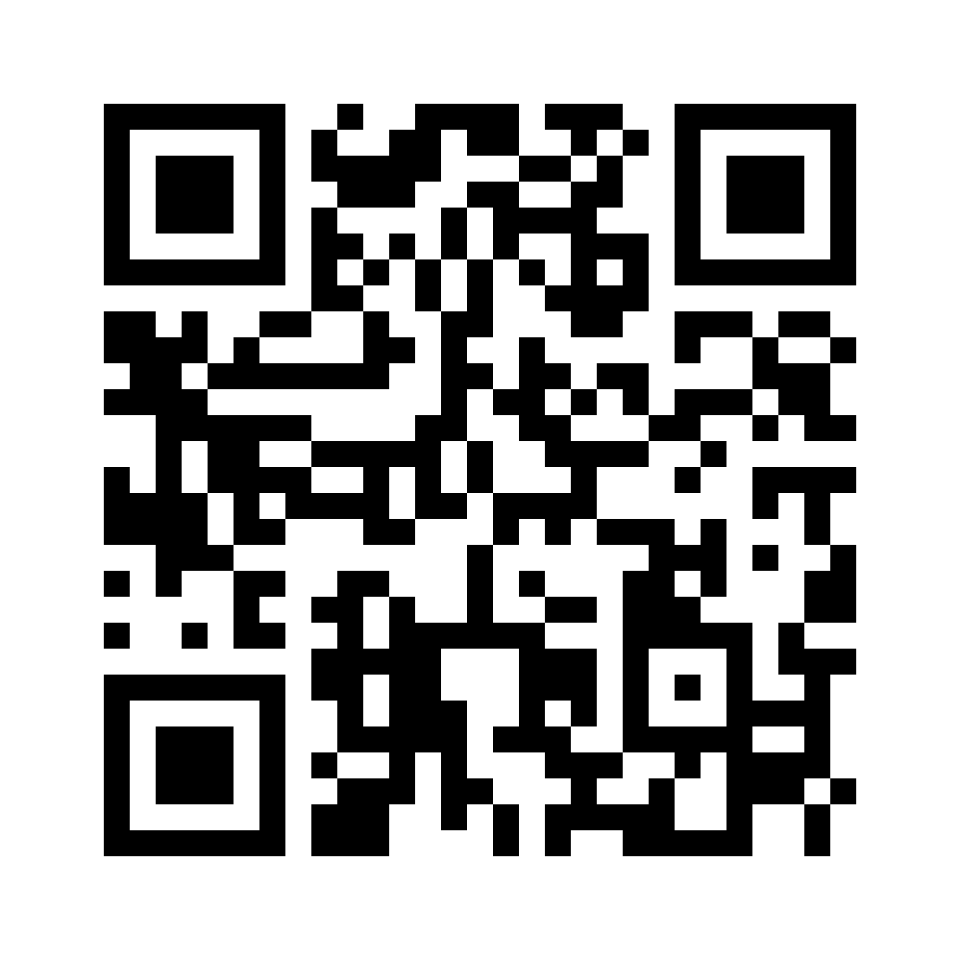

Please complete you session evaluations
https://www.sqlsatbr.com/session-evaluations

